Slide 1


Factory Method Learning App:
Instructional Design & Software Engineering Overview
Group 7:
Charl Pieter Pretorius: u22519042
James Fitzsimons: u21516741
Ivan Horak: u21456552
Notes:
Project Title: Modern Tech & Education
Authors: [Your Names Here]
[Cool Setswana/AI Graphic]

Slide 2


Introduction
In a Nutshell
  Post-lecture web app for COS214 that helps students recognise, diagram and implement the Factory Method (FM) pattern in C++, and shows when a student needs intervention.
  Our COS214 experience
  Students often confuse FM with “wrapper around new”, keep clients coupled to concrete classes, and struggle to connect UML diagrams with C++ code. The app gives structured practice and feedback on these pain points.
  Educational Software Development
  The app prototype is designed using a Dick & Carey Instructional Design model and a Software Engineering approach.
  We’ll do the live demo after layout out the theory.
Notes:
Project Title: AI Innovations in Setswana
Authors: [List of Authors]
[Placeholder for Cool Setswana/AI Graphic]

Slide 3
Instructional Design Foundations
  Dick & Carey gives us the overall structure: we start from performance goals (what students must do with Factory Method), derive learning outcomes, design assessments first, and then backfill micro-lessons and activities to support those outcomes.
  Gagné’s Nine Events and Merrill’s First Principles shape each learning sequence: we open with a concrete “creation variability” problem, present worked examples of canonical FM, guide practice, give immediate feedback, and close with transfer tasks such as refactoring naive code.
  We blend learning theories and styles: behaviourism (clear criteria and mastery bands), cognitivism (chunked explanations, UML+code dual coding), and constructivism (refactor and extend tasks), while catering for VARK preferences through visuals, short readings and hands-on coding.
Notes:
Understanding the current challenges and opportunities in leveraging AI for Setswana language. [Placeholder for Split with Stats/Quotes/Icons]

Slide 4
Factory Method: Learning Problem & Design Goals:
  COS214 students often collapse Factory Method into a “wrapper around new”, or confuse it with Abstract Factory. They battle to see what varies (creation) versus what should remain stable (client and product interface).
  On the C++ side, learners struggle to map the UML roles to concrete code: virtual constructors, correct return types, ownership, and especially the need for a virtual destructor in the Product hierarchy.
  Our app is designed to target these specific misconceptions through short, focused tasks and rich feedback, so that students leave with a robust mental model of when to apply Factory Method and how to implement it correctly in C++.
Notes:
Understanding the current challenges and opportunities in leveraging AI for Setswana language. [Placeholder for Split with Stats/Quotes/Icons]

Slide 5

The Importance Of Feedback
  Constructive feedback is crucial for student learning (Sapire & Roberts, 2023).
  Students value feedback that goes beyond correction, appreciating emotional support, encouragement, and meaningful engagement from teachers (Rowe, 2011).
  From the research just mentioned we extract six pedagogically relevant dimensions for feedback: Constructive, Encouraging, Polite, Relevant, Concise, and Corrective.
  These guide how Gemini greatest feedback for the COS214 students.
Notes:
Understanding the current challenges and opportunities in leveraging AI for Setswana language. [Placeholder for Split with Stats/Quotes/Icons]

Slide 6
Learners and Target Outcomes
  Our primary learners are second-year COS214 students who have seen Factory Method in class but still need guided practice. The app MVP is positioned as a post-lecture companion rather than a replacement for the lecture.
  We assume basic C++ syntax, OO concepts and simple UML class diagram experience, but expect variability in UML fluency, pointer/reference confidence and general design-pattern experience. Item analytics help surface these gaps without blocking progress.
  By the end of the unit, students should be able to explain when Factory Method is appropriate, read and create its UML structure, implement it correctly in C++, and distinguish it from related patterns such as Abstract Factory.
Notes:
Understanding the current challenges and opportunities in leveraging AI for Setswana language. [Placeholder for Split with Stats/Quotes/Icons]

Slide 7


Factory Method: Major Learning Outcomes:
Know and understand the key aspects and intent of the Factory Method pattern, including its classification as a creational pattern, its canonical structure, and the programming problem it solves.
Analyse and apply Factory Method UML class diagrams from given code or contexts: produce, scan and label FM diagrams, and distinguish FM from similar patterns in UML.
Understand, analyse and apply the Factory Method pattern in C++ coding contexts: implement FM, trace which factory override executes, refactor naive clients to FM, and extend existing FM implementations safely.
Explain how Factory Method interacts with other design patterns and combine FM with related patterns (for example Abstract Factory or Memento) to solve design problems.
Notes:
What are the potential applications and impacts of AI innovations in the Setswana language? [Placeholder for Bold, Clean Research Question]

Slide 8


Instructional Strategy & Assessment:
Micro-lessons and strands (Non-MVP):
  Theory (T*) and coding (C*) micro-lessons are planned around creation variability, canonical FM structure, pitfalls and C++ lifecycle details.
  Each lesson follows Gagné’s events: attention-grabbing scenario, objectives, recall, worked example, guided practice, and quick checks.
  Lessons are split into three strands: UML, code, and recognition, so that later items can target specific strands and learning outcomes.
Micro-Quizzes and FM coding practical
  Six Micro-Quizzes (MQs), each 7 marks, mix UML-label, code-read, trace, refactor and intent items, with immediate feedback and LO tags.
  Global policy: total MQ time ≤ 60 minutes and ≤ 30 marks, with unlimited retries for learning but only the first graded attempt counting.
  A scaffolded C++ reporting utility serves as the FM coding practical: students implement Products and Creators, pass unit tests and structural checks, and optionally extend the design with a new exporter.

Slide 9

Architecture & Core Features
  Front-end: React + TypeScript single-page app with a Monaco-based C++ editor and a custom UML canvas. Feature slices cover Lessons*, Micro-Quiz Engine, UML Workbench, Code Practical and Analytics views.
  API & grading service: FastAPI/Node backend delivers content, evaluates items and ingests analytics. Grading stack = containerised C++ runner with unit tests + static FM invariants, with Gemini-2.5-Pro used to generate formative explanations and feedback (formative marks, but not summative marks).
  Data & analytics: A .jsonl stores content, attempts and mastery bands, with an attempt-event log {session, item, LO ids, pass/fail, time, error class}. Dashboards and CSV export show per-student and cohort mastery and the most common error classes.
Notes:
Understanding the current challenges and opportunities in leveraging AI for Setswana language. [Placeholder for Split with Stats/Quotes/Icons]

Slide 10


Example JSON Data for Diagnostic Analysis
One JSON entry for a student doing MQ1.1:
{"ts": 1763385216060, "student_id": "u22519042", "session_id": "ed29e739-81ef-4ac4-8202-392660e28c2f", "mq_id": "mq1", "item_id": "mq1_q1", "lo_ids": [1, 2, 3, 4], "pass_fail": 0, "attempts": 1, "time_ms": 0, "error_class": "intent-or-classification-misunderstood", "remedial_clicked": false, "marks_awarded": 0, "marks_possible": 2}
Notes:
Generating synthetic data using advanced prompt techniques. [Placeholder for Visualize Prompt → Synthetic Data]

Slide 11


MVP, Risks & Future Work:
MVP: Factory Method strand only – MQs, coding practical with tests, UML label/build, basic analytics + CSV export. MQs available via a direct “Start MQ” flow while lessons are still in progress.
Deferred: Rich lesson UI, FM vs AF vs Simple Factory discrimination, advanced lecturer dashboards, cohort trends, and a visual content-authoring tool.
Risks: C++ compile latency, brittle static checks, and scope creep; mitigated with caching, paired tests + feedback, and a strict MVP cutline.
Future: Add more patterns, use real COS214 data for diagnostics and summative support, and refine materials from analytics while carefully controlling any GenAI-generated content.
Recommended: Lecturer records clips explaining a single context, to be paired with micro lessons.

Slide 12
Thank You!
Group 7:
Charl Pieter Pretorius: u22519042
James Fitzsimons: u21516741
Ivan Horak: u21456552
On to the Demo!
Notes:
Reflecting on key insights and pondering future possibilities. [Placeholder for Bold, Striking Closing Question]

Slide 13

Corpus Generation
Dataset:
  A synthetic Setswana feedback dataset in JSON format was created using the ChatGPT-4.1 API. Unlike prior work that only used LLMs for labelling, we used ChatGPT-4.1 ( the latest iteration ) to both generate and label feedback, controlling the distribution of quality labels. This approach enables comprehensive coverage of feedback types for robust model training.
  Generation Categories:
      Label-Focused Variation: For each of the six quality labels, ChatGPT-4.1 was prompted to generate feedback that spanned low (0–0.3), medium (0.3–0.6), and high (0.6–1) values, ensuring full coverage.
      Temperature Variation: Mixed-label feedback was generated at multiple temperature settings (0.0, 0.3, 0.4, 0.5, 0.6, 0.7, 1.0), increasing diversity and robustness.
      Combined: Combined all previous JSONs to maximize label diversity.
  Details:
      Entries: Each JSON entry consists of feedback in Setswana, its English translate and the label array for the Setswana feedback.
      Number of Entries: 26 JSON files where each has 120 to 150 entries.
      Cost: The final dataset cost was about R2.10 per JSON with a final cost of R50.
Notes:
Generating synthetic data using advanced prompt techniques. [Placeholder for Visualize Prompt → Synthetic Data]

Slide 14
Methodology:
Data Preprocessing
  Used the combined (“Category Three”) dataset.
  Data split into 80% training, 20% testing for unbiased evaluation.
Subword Tokenization
  XLM-RoBERTa tokenizer applied at the subword level.
  Designed for morphologically rich, low-resource languages like Setswana.
Embedding
  Tokenized feedback converted into dense vector embeddings via XLM-RoBERTa.
  Enables the model to learn meaningful semantic features.

Slide 15
Experiments and Results: Performance Metrics
Label | MSE x100 | MAE x100 | R Squared
Constructive | 1.51 | 8.11 | 0.8053
Encouraging | 0.93 | 6.75 | 0.8982
Polite | 1.12 | 7.6 | 0.6766
Relevant | 1.01 | 6.92 | 0.7638
Concise | 0.76 | 6.34 | 0.7634
Corrective | 1.62 | 7.41 | 0.8673
Average | 1.16 | 7.12 | 0.7958

Slide 16
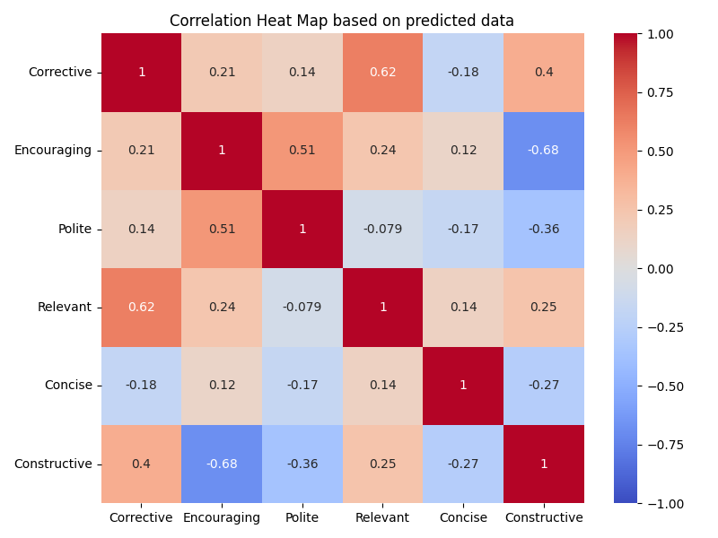
Experiments and Results: Correlation Heat Map

Slide 17
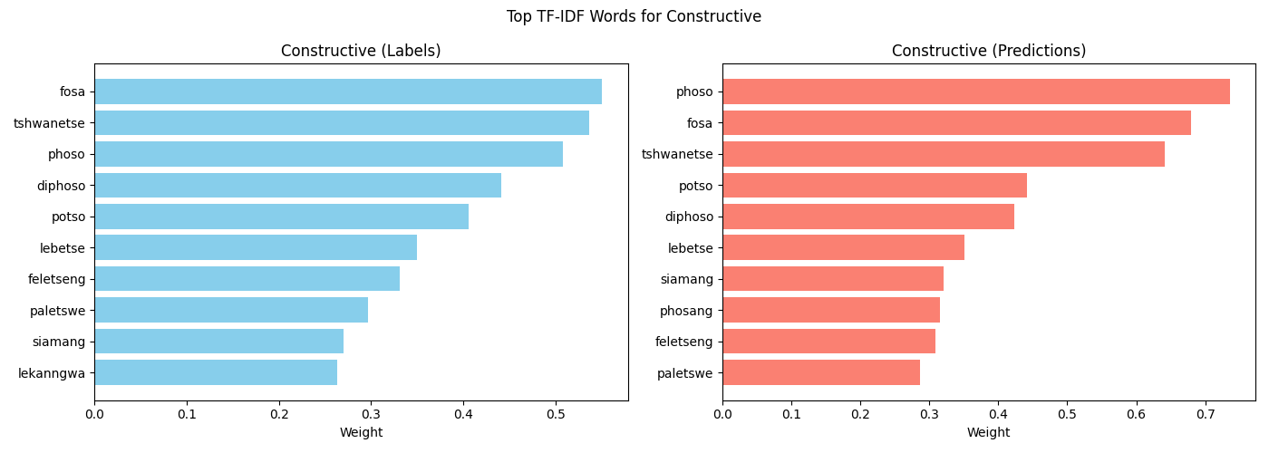
Experiments and Results: TF-IDF

Slide 18

Experiments and Results: SHAP
Sample Sentence:
O ne wa fosa go tlhalosa pharologanyo magareng ga virus le bacteria mo Life Sciences. Leka go ithuta gape ka tsone.
Encouraging (0.404):
Corrective (1.075):

Slide 19
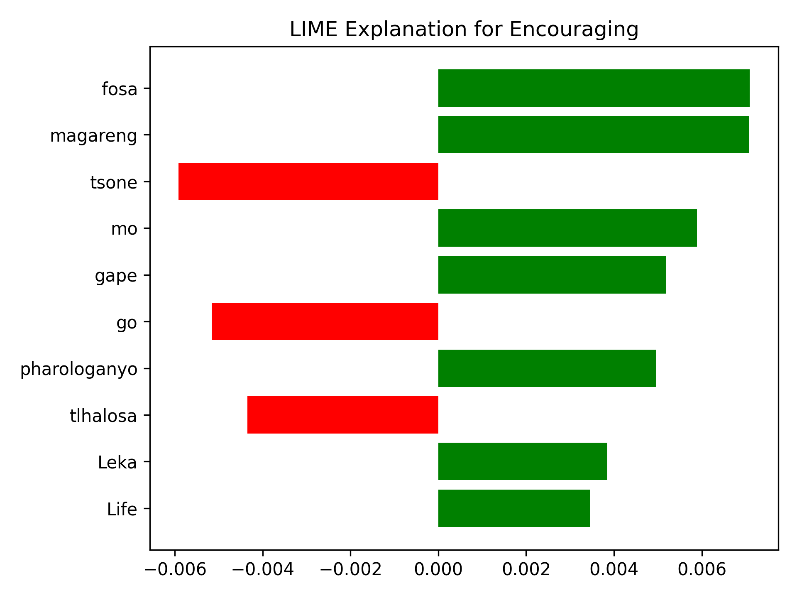
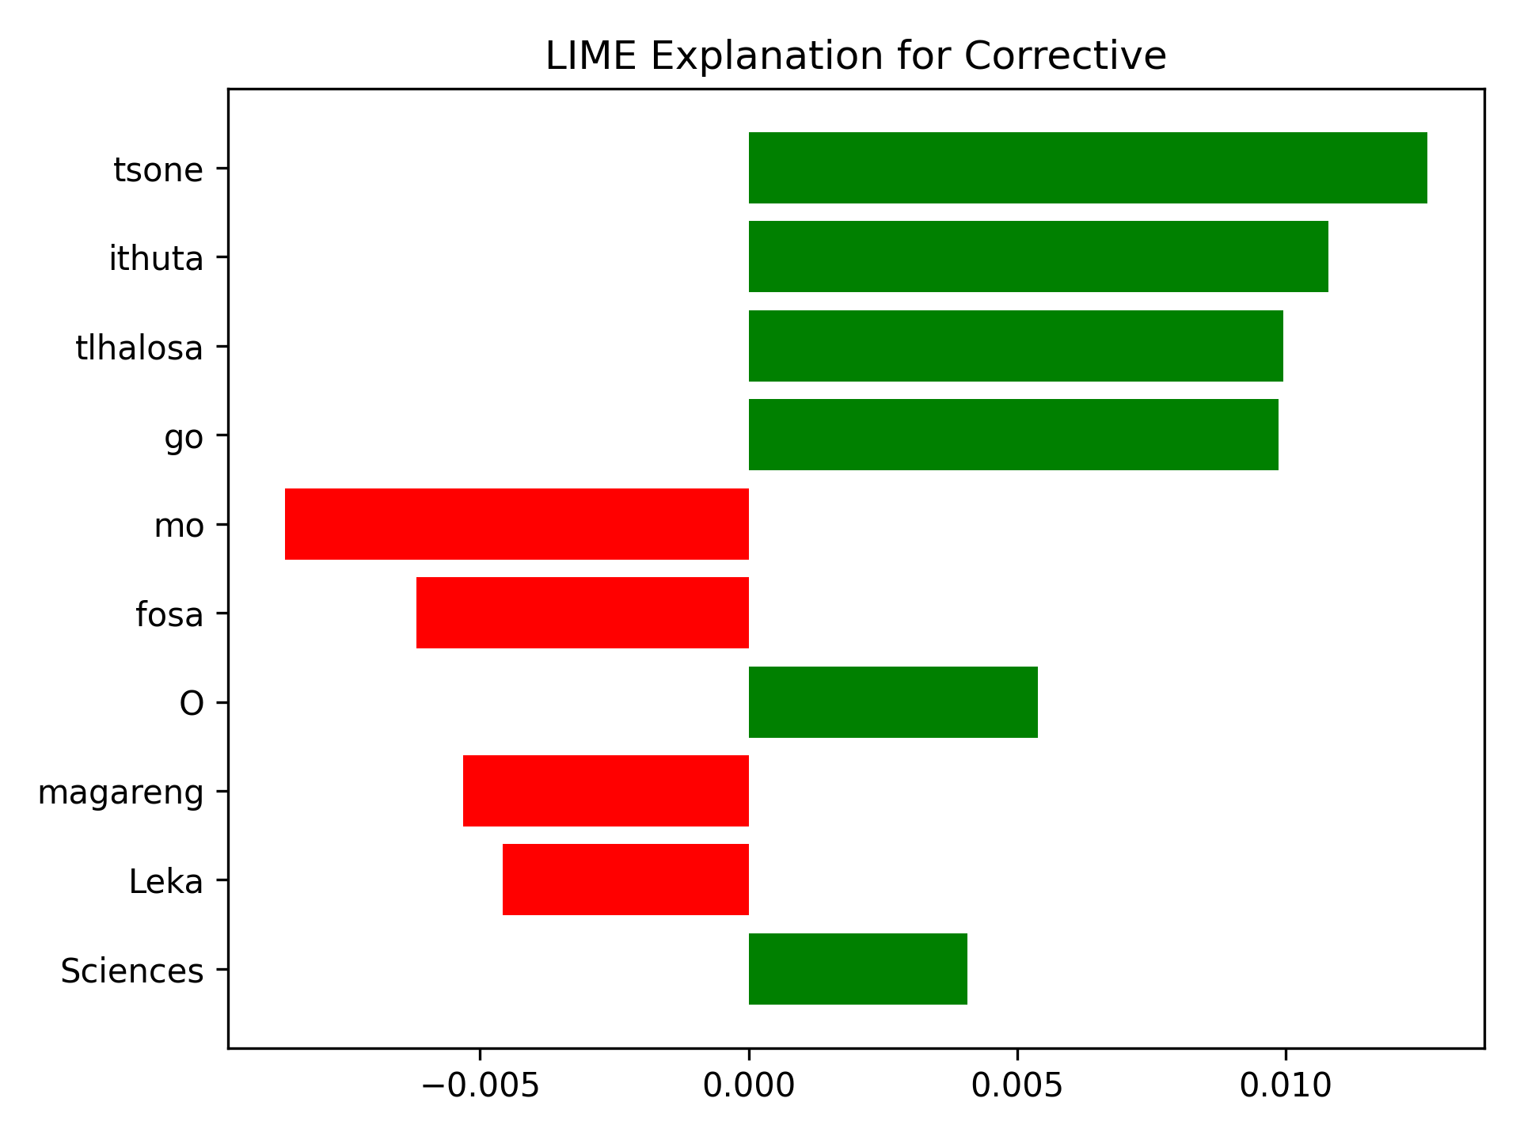
Experiments and Results: LIME
Sample Sentence:
O ne wa fosa go tlhalosa pharologanyo magareng ga virus le bacteria mo Life Sciences. Leka go ithuta gape ka tsone.
Encouraging (0.404):
Corrective (1.075):

Slide 20
Project Goal:
Leverage systematic prompt engineering to create a diverse Setswana Feedback dataset, which is then used to fine-tune a subword-aware XLM-RoBERTa model for automated feedback quality assessment across six pedagogically relevant educational dimensions:
Constructive — provides actionable suggestions
Encouraging — offers praise or emotional support
Polite — uses respectful language
Relevant — addresses the student’s work directly
Concise — avoids verbosity
Corrective — clearly identifies errors
The aim is to support the delivery of high-quality, home-language feedback to students in African language schools by providing a way to cost effectively evaluated generated and real-world teacher feedback.

Slide 21
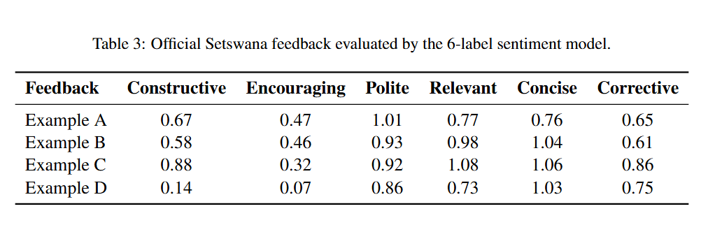
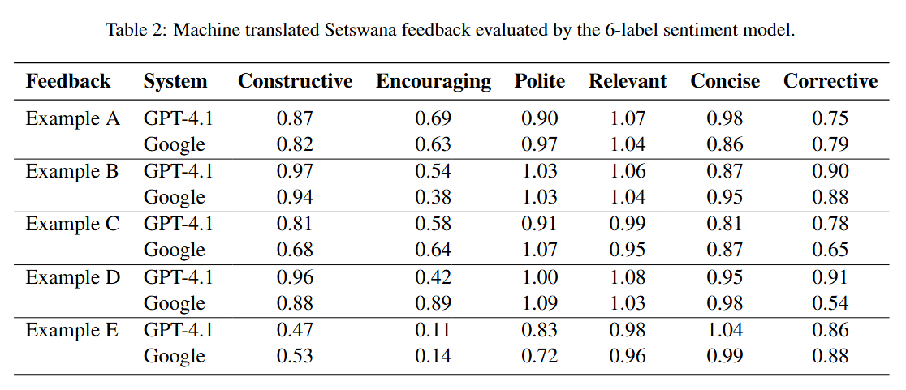
Experiments and Results: Real Feedback Tested
Sample Sentence
  Bokhutlo bo agilwesentle mme bo ka dirisa puo e ntsi yasetegeniki kgotsa mafoko a botlhokwa.
  The conclusion is well constructed but could use more technical language or keywords.
Results
  Constructive — 0.81
  Encouraging — 0.58
  Polite — 0.91
  Relevant — 0.99
  Concise — 0.81
  Corrective — 0.78
Notes:
Lack Setswana speark
Did well from English translation
Shows promise for future work through adaptability to OOV

Slide 22
Conclusion
  Synthetic feedback data for Setswana can be generated and labelled using large language models.
  This opens the door for cost-effective, subword-aware neural models for automated feedback quality assessment and beyond.
  Using ChatGPT-4.1 and likely other new-gen LLMs for data generation and annotation could directly address the data scarcity challenge in low-resource languages.
  The approach provides a practical, adaptable pipeline for sub-word tokenization in Setswana and other African languages.
  Thus, the methodology should be generalisable to other low-resource languages needing a labelled corpus.
Notes:
Understanding the current challenges and opportunities in leveraging AI for Setswana language. [Placeholder for Split with Stats/Quotes/Icons]

Slide 23
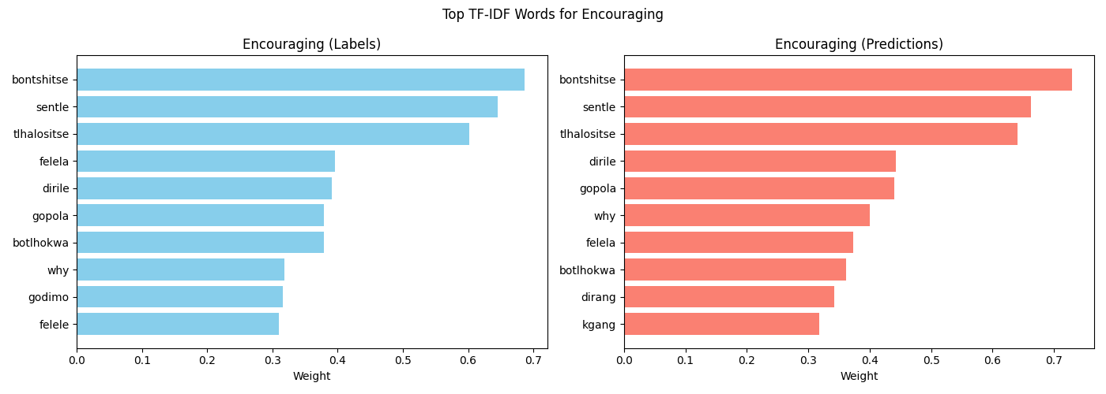
XLM-RoBERTa vs ChatGPT-4.1
  The models emphasize different sub-word patterns. ChatGPT likely relies more on global sentence cues, while RoBERTa focuses on subword-level details.
  Interpretability tools (SHAP, LIME, TF-IDF) reveal the neural model in general has different weights compared to ChatGPT-4.1, interestingly we see that the ‘Encouraging’ label is the only label with the exact same top three weights.
  Despite the limited dataset, the subword-aware model seems to have learned some nuances of Setswana feedback that even Chat struggles with.
  This highlights potential for refining both data generation and model training strategies to improve.
Notes:
Understanding the current challenges and opportunities in leveraging AI for Setswana language. [Placeholder for Split with Stats/Quotes/Icons]

